Slide 1
Machine Learning
Liz Lorenzi and Isaac Lavine

Slide 2
Regression Modeling
Model a continuous response variable Y with covariates X
We will cover:
Linear Models
Regularized Models (Lasso, Ridge regression)
Tree-based methods

Slide 3

Linear Models
A linear model is of the form
$$Y=β_{0}+β_{1}X_{1}+ …+β_{p}X_{p}$$
Linear models assume a linear relationship between each covariate

Slide 4
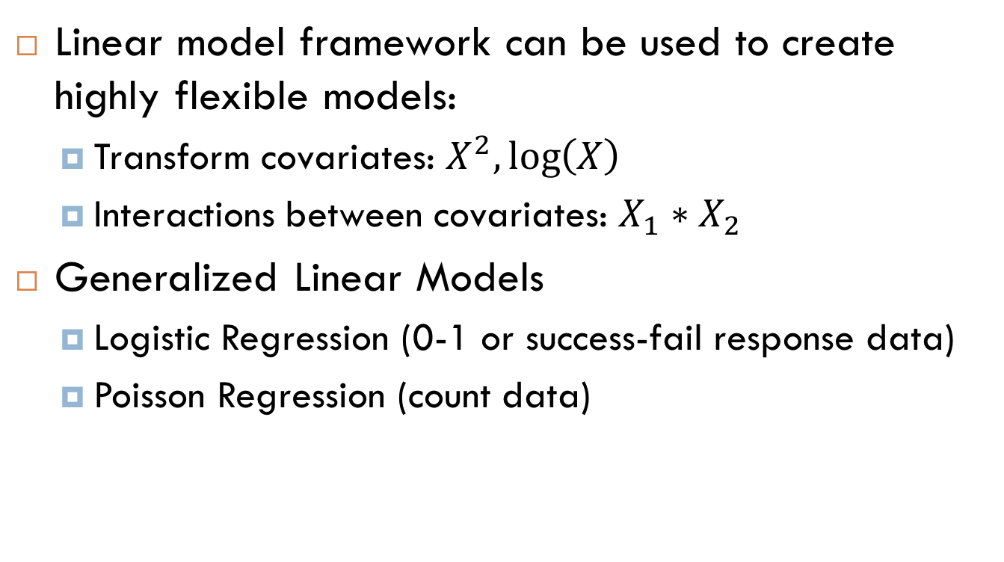
Linear Models
Linear model framework can be used to create highly flexible models:
Transform covariates: $X^{2},\log\left(X\right)$
Interactions between covariates: $X_{1}∗X_{2}$
Generalized Linear Models
Logistic Regression (0-1 or success-fail response data)
Poisson Regression (count data)
Notes:
Example of a variable with a squared relationship to an object: Physics, if you fire a cannonball, then it will travel in a parabola, so the height will relate to x^2
Example of an interaction term that you might want to include in your model:

Slide 5
Linear Models in R
lm(formula, data) function
Formulas:
Home_Value ~ Num_Beds + Neighborhood
Home_Value ~ Neighborhood*Schools + Num_Beds
Home_Value ~ .

Slide 6
Generalized Linear Models in R
glm(formula, data, family)
Formula and data exactly the same as in lm()
Family = ’binomial’ for 0-1 response variable
Family = ‘poisson’ for count data
For help on glm or families, type:
?glm
?family
We’ll come back to this later on in the workshop

Slide 7
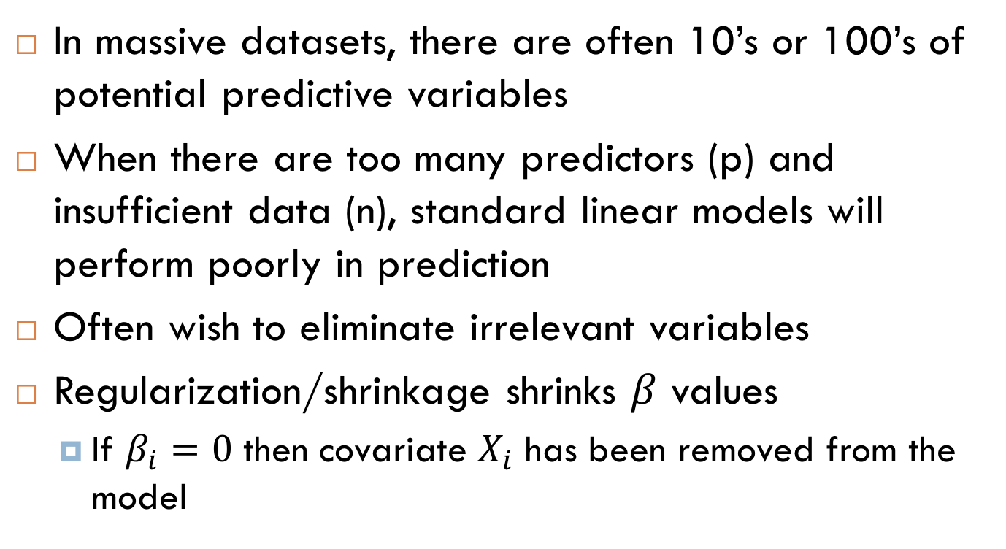
Regularized Linear Models
In massive datasets, there are often 10’s or 100’s of potential predictive variables
When there are too many predictors (p) and insufficient data (n), standard linear models will perform poorly in prediction
Often wish to eliminate irrelevant variables
Regularization/shrinkage shrinks $β$ values
If $β_{i}=0$ then covariate $X_{i}$ has been removed from the model

Slide 8
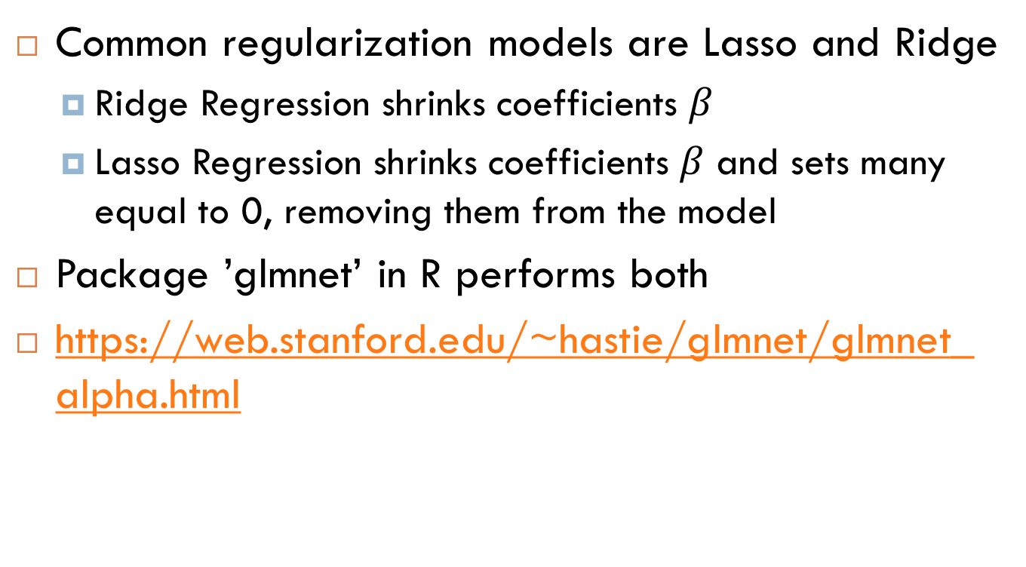
Regularized Linear Models
Common regularization models are Lasso and Ridge
Ridge Regression shrinks coefficients $β$
Lasso Regression shrinks coefficients $β$ and sets many equal to 0, removing them from the model
Package ’glmnet’ in R performs both
https://web.stanford.edu/~hastie/glmnet/glmnet_alpha.html

Slide 9
Resampling Methods
Cross Validation
Technique to avoid overfitting to a dataset
Hold out some data, test model accuracy against held out ‘validation’ data
E.g. Hold out 1/10 of data 10 times, get complete error rate
Bootstrapping
Resample complete dataset with replacement
Repeatedly re-fit model to estimate uncertainty in parameter values

Slide 10
Workshop – Linear Models
library(MASS) contains the ‘Boston’ dataset
We will predict median home value
library(glmnet) contains lasso and ridge regression
If these are not installed, use the following commands:
install.packages(“MASS”)
install.packages(“glmnet”)

Slide 11
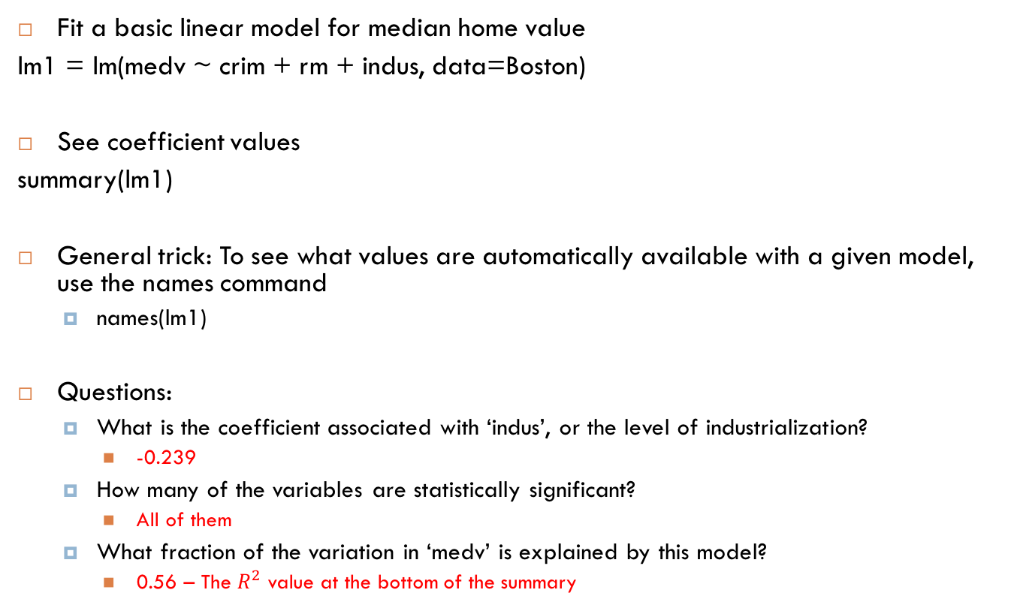
Workshop – Linear Models
Fit a basic linear model for median home value
lm1 = lm(medv ~ crim + rm + indus, data=Boston)
See coefficient values
summary(lm1)
General trick: To see what values are automatically available with a given model, use the names command
names(lm1)
Questions:
What is the coefficient associated with ‘indus’, or the level of industrialization?
-0.239
How many of the variables are statistically significant?
All of them
What fraction of the variation in ‘medv’ is explained by this model?
0.56 – The $R^{2}$ value at the bottom of the summary

Slide 12
Workshop – Linear Models
Fit a linear model with the same variables, but include interactions
lm2 = lm(medv ~ crim*rm*indus, data=Boston)
Questions:
What is the coefficient value associated with ‘indus’?
2.37
How has it changed from the previous model?
It has flipped sign – it’s not positive. This is because we are accounting for more variables now. Notice that the interaction between indus and rm, and indus and crime are both negative, reflecting the negative effect we saw in the first linear model. The flipped effect is called Simpson’s Paradox.

Slide 13
Workshop – Linear Models
Fit a linear model with all variables in the Boston dataset (hint: you don’t need to type them all in)
lm3 = lm(medv ~ ., data=Boston)
Questions:
What fraction of the variation in ‘medv’ is explained by this model? Why is this higher than in model 1?
0.74. Because there are more explanatory variables in the model, we will always explain more of the variation in the median home value. Statistically significant variables explain more of the variation in home value than we would expect based on random chance.
How many of the variables are considered statistically significant?
12 are significant (including the intercept), 2 are insignificant

Slide 14
Workshop – Shrinkage Methods
We will be working with the glmnet package
Strongly encouraged to explore and go beyond the basic workshop:
?glmnet
?cv.glmnet
Online tutorial to glmnet: google ‘glmnet’ and select the 2nd link, from web.stanford.edu

Slide 15
Workshop – Lasso Regression
glmnet only takes in matrices, does not work with formulas. Built in R function to go from a formula to a design matrix:
X = model.matrix(medv ~ . - 1, data=Boston)
Y = Boston$medv
Now fit the lasso model with cross validation
lasso = cv.glmnet(X, Y)
Runs cross-validation to determine the optimal shrinkage on parameters. Criterion is minimizing the error on cross-validation data.

Slide 16
Workshop – Lasso Regression
Plot the Mean Squared Error versus Shrinkage level
plot(lasso)
Find the coefficients
coef(lasso)
Questions:
Which variables have been removed from the model?
‘indus’ and 'age’
Do these correspond to the statistically insignificant variables from the regular linear model?
Yes – can check by going back to: summary(lm3)
What is the optimal value of the shrinkage parameter?
0.028 – command is: lasso$lambda.min

Slide 17
Workshop – Ridge Regression
Fit a ridge model (use the introduction and help files):
ridge = cv.glmnet(X, Y, alpha = 0)
Questions:
Look at the coefficients. Have any covariates been eliminated from the model?
No, ridge regression shrinks correlated coefficients towards each other, but does not ‘choose’ some to discard and others to keep
Save the fitted values of the model to the Boston data. What are the first 2 fitted values?
ridge.fitted = predict(ridge, newx = X, s = "lambda.min")
30.3 and 25.2
Note that we used the ‘predict’ function, and set newx=X. If there was test data that we wanted to predict, would simply set newx = X.test

Slide 18
Workshop – Ridge and Lasso
First save the fitted values from the lasso regression:
lasso.fitted = predict(lasso, newx=X, s="lambda.min")
Compare the first couple values to the real data. How do the predictions looks?
head(ridge.fitted)
head(lasso.fitted)
head(Boston$medv)
Plot the fitted versus real values for both ridge and lasso. Can you add in the x=y line, which is a perfect fit?
plot(ridge.fitted, Boston$medv)
plot(lasso.fitted, Boston$medv)
abline(a=0, b=1) – use this after each plot above

Slide 19
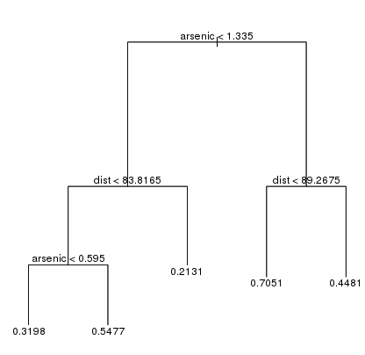
Tree-based Methods
Model outcome Y by a series of ‘splits’ or decisions on covariates
More flexible, non-parametric models
No interpretable covariate effect
Performs well with large datasets

Slide 20
Random Forests
A random forest is created from a succession of decision trees
Each tree is fit to a random sample of the training data
Predictions are made by averaging across different trees
Can provide a measure of variable ‘importance’, but still no interpretable effect
Library ‘randomForest’ in R

Slide 21
Workshop – Random Forests
Load the random forest package:
Library(‘randomForest’)
Fit a random forest to the Boston dataset
rf = randomForest(medv ~ ., data=Boston, importance=TRUE)
Plot the mean squared error
plot(rf)
Note that the mean squared error decreases as the random forest grows more and more decision trees

Slide 22
Workshop – Random Forests
Questions:
What are the most important variables?
importance(rf)
‘rm’ and ‘lstat’ – the average number of rooms per house, and the percent of the population in poverty
Save the fitted values and plot them versus the medv
rf.fitted = predict(rf)
plot(rf.fitted, Boston$medv)
What is the mean squared error for the random forest with all 500 trees?
9.44
rf$mse – only look at the last value

Slide 23
Workshop – Model Comparison
Code:
plot_data = data.frame(Boston$medv, lasso.fitted, ridge.fitted, rf.fitted)
names(plot_data) = c("MedValue", "Lasso", "Ridge", "Random.Forest")
p = ggplot(plot_data, aes(y = MedValue))
p + geom_point(aes(x = Lasso), color="Blue") + geom_point(aes(x = Ridge), color="red") + geom_point(aes(x = Random.Forest), color="green") + geom_abline(slope=1)

Slide 24
Workshop – Model Comparison
Clearly the random forest has fit the data better than the other models. Why?
In what situations would the random forest not have an advantage over lasso and ridge regression?
Would the results be similar on test data not used to fit the model?

Slide 25
Classification – Generalized Linear Models
Different than previous regression techniques, where the goal was to predict a continuous outcome (like income or home value)
Logistic Regression: Goal is to predict a success/fail outcome, or 0-1 outcome
E.g. Life/Death after surgery, Win/Lose in sports, buy/don’t buy in advertising, etc…
Poisson Regression: Goal is to predict an integer value
E.g. number of arrests in a district
Often can be approximated using standard regression techniques for continuous variables

Slide 26
Workshop – Logistic Regression
library(ISLR) to get the Smarket dataset
?Smarket
Goal is to predict the direction of the stock market (up/down) using returns from the previous 5 days
If you could actually model this problem better than other people, you’d be very rich

Slide 27
Workshop – Logistic Regression
Fit the logistic regression
glm1 = glm(Direction ~ Lag1 + Lag2 + Lag3 + Lag4 + Lag5 + Volume, data=Smarket, family=binomial)
None of the lags are statistically significant
Lag1 has the smallest p-value (closest to significance)
Questions:
What are the first 3 fitted values, and what are the first 3 true directions?
Up, Up, Down is the truth, fitted is 0.51, 0.48, 0.48
Create a table of the predicted decision versus the truth, evaluate the accuracy rate of the predictions that the market will increase
table(glm1.fitted > 0.5, Smarket$Direction)
accuracy = (507) / (457 + 507)

Slide 28
Workshop – Logistic Regression
To gain a more accurate representation of the test error rate, we will fit a model on data from 2001-2004, and then test on 2005 data
Tasks:
Separate the data into ‘training’ and ‘test’
train = subset(Smarket, Year < 2005)
test = subset(Smarket, Year == 2005)
Fit the logistic model on the training data
glm2 = glm(Direction ~ Lag1 + Lag2 + Lag3 + Lag4 + Lag5 + Volume, data=train, family=binomial)
Obtain predictions for the test data
glm2.fitted = predict(glm2, newx = test, type="response")
Evaluate accuracy with a boxplot or table
table(glm2.predict > 0.5, test$Direction)
44 / (34 + 44)
Compare accuracy to the ‘null’ model – i.e. always guessing an increase
sum(test$Direction == "Up") / length(test$Direction)

